Slide 1
Dilated Neural Networks for Time Series Forecasting
Chenhui Hu
Data Scientist
Microsoft Cloud & Enterprise

Slide 2
Agenda
Overview of Time Series Forecasting Methods
Foundations of Dilated Convolutional Neural Networks
Application to Retail Demand Forecasting

Slide 3
Agenda
Overview of Time Series Forecasting Methods
Foundations of Dilated Convolutional Neural Networks
Application to Retail Demand Forecasting

Slide 4



Overview
Time Series Forecasting Applications
retail sales forecasting
financial forecasting
web traffic forecasting

Slide 5
Representative Methods
Exponential
Smoothing
LSTM
Boosted Decision Trees
Seq2Seq LSTM
ARIMA
Support Vector Regression
Bayesian
Approach
Random Forest
Lasso
Regression
GRU
Dilated CNN
GARCH
1950s
early 1970s
late 1970s
1980s
1995
1996
1997
1999
2014
2016
Surge of DNN
methods
Statistical Methods
Classic Machine Learning
Deep Learning
J. Gooijer and R. Hyndman. 25 Years of Time Series Forecasting.

Slide 6
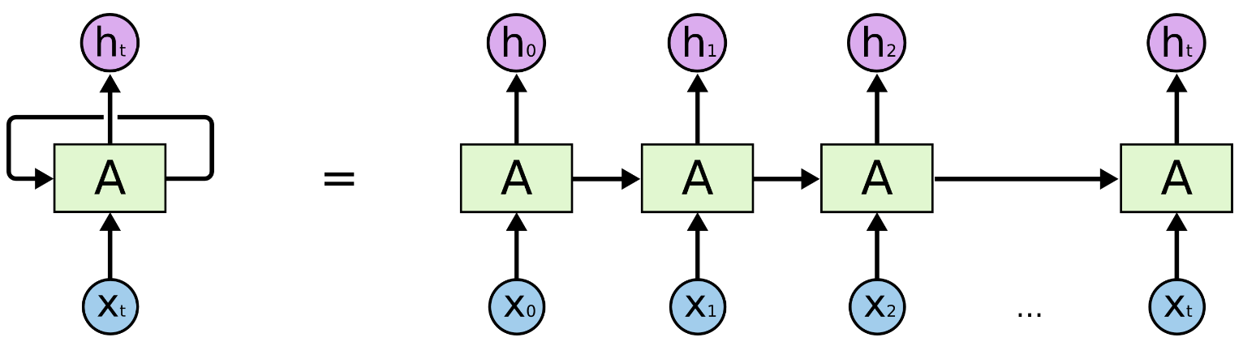
Recurrent NN
RNN models the order of the data explicitly
Long Short-Term Memory (LSTM) network models long-range dependencies
y₀
y₁
y₃
…
y_{n}
y_{t}
y₀
y₁
y₂
y_{t}
…
x₀
x₁
x₂
…
x_{t}
unrolled Recurrent Neural Network (RNN)
multi-layer perceptron
http://colah.github.io/posts/2015-08-Understanding-LSTMs/

Slide 7
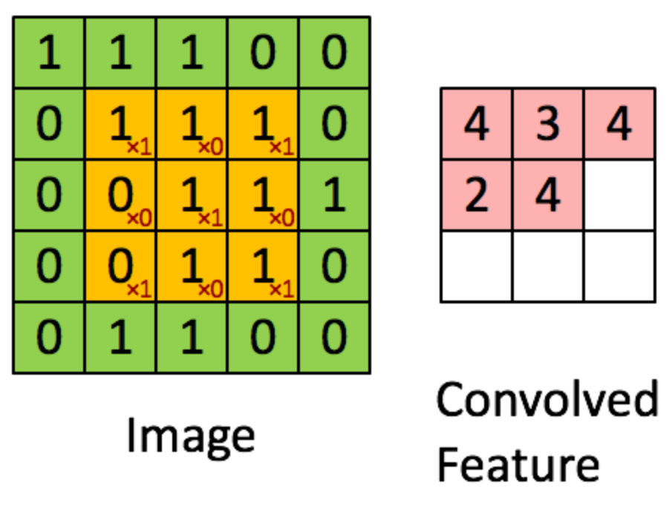
Convolutional NN
Success of CNN in CV and recently in NLP
        Outperforms human in many computer vision tasks
        Achieves state-of-the-art accuracy in audio synthesis & machine translation
MLP with convolution layers
convolved
feature
image
2D convolution as a linear combination of pixel values in a neighborhood

Slide 8
RNN vs. CNN
RNN
        Has been default DL choice for sequence modeling
        Can learn long-range dependencies effectively
        But training is usually slower compared with CNN
CNN
        Lower level of model complexity
        Easy to parallelize the computation
        Dilated CNN can outperform RNN in sequence modeling

Slide 9
Agenda
Overview of Time Series Forecasting Methods
Foundations of Dilated Convolutional Neural Networks
Application to Retail Demand Forecasting

Slide 10
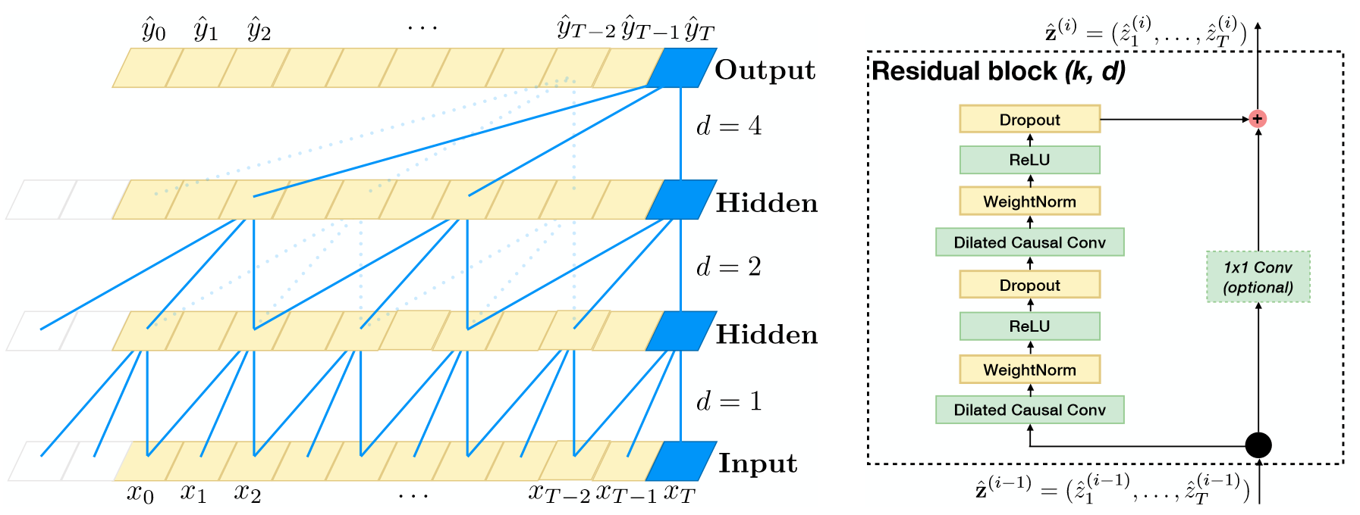
Dilated CNN Overview
CNN with dilated causal conv. layers
        Basic setup: dilated conv. layers + output layer
        Advanced: skip connections, dropout, batch normalization, gated activation units, …
Examples
        WaveNet for audio synthesis
        Temporal CNN for sequence modeling
S. Bai, J. Kolter, and V. Koltun. An Empirical Evaluation of Generic Convolutional and Recurrent Networks for Sequence Modeling.
.

Slide 11

1-D Convolution for Time Series
 | Feature 1 | Feature 2 | Feature 3 | Feature 4
Timestamp 1 | 0.4 | 0.8 | 0.5 | 0.7
Timestamp 2 | 0.7 | 0.3 | 0.6 | 0.7
Timestamp 3 | 0.8 | 0.4 | 0.9 | 0.2
Timestamp 4 | 0.1 | 0.5 | 0.8 | 0.5
Timestamp 5 | 0.4 | 0.8 | 0.7 | 0.1
Timestamp 6 | 0.3 | 0.0 | 0.2 | 0.6
Timestamp 7 | 0.2 | 0.5 | 0.8 | 0.2
Timestamp 1, 2, 3 | 4.9
Timestamp 2, 3, 4 | 1.9
Timestamp 3, 4, 5 | 2.3
Timestamp 4, 5, 6 | 1.0
Timestamp 5, 6, 7 | 3.3
1 | 2 | -3 | 1
-1 | 1 | -2 | 2
2 | 2 | 1 | 3
Filter
kernel
size = 3

Slide 12
1-D Convolution for Time Series
 | Feature 1 | Feature 2 | Feature 3 | Feature 4
Timestamp 1 | 0.4 | 0.8 | 0.5 | 0.7
Timestamp 2 | 0.7 | 0.3 | 0.6 | 0.7
Timestamp 3 | 0.8 | 0.4 | 0.9 | 0.2
Timestamp 4 | 0.1 | 0.5 | 0.8 | 0.5
Timestamp 5 | 0.4 | 0.8 | 0.7 | 0.1
Timestamp 6 | 0.3 | 0.0 | 0.2 | 0.6
Timestamp 7 | 0.2 | 0.5 | 0.8 | 0.2
Timestamp 1, 2, 3 | 4.9
Timestamp 2, 3, 4 | 1.9
Timestamp 3, 4, 5 | 2.3
Timestamp 4, 5, 6 | 1.0
Timestamp 5, 6, 7 | 3.3
1 | 2 | -3 | 1
-1 | 1 | -2 | 2
2 | 2 | 1 | 3
Filter
kernel
size = 3

Slide 13
1-D Convolution with Multiple Filters
 | Filter 1 | Filter 2
Timestamp 1, 2, 3 | 4.9 | 7.4
Timestamp 2, 3, 4 | 1.9 | 7.3
Timestamp 3, 4, 5 | 2.3 | 6.8
Timestamp 4, 5, 6 | 1.0 | 5.1
Timestamp 5, 6, 7 | 3.3 | 5.7
 | Feature 1 | Feature 2 | Feature 3 | Feature 4
Timestamp 1 | 0.4 | 0.8 | 0.5 | 0.7
Timestamp 2 | 0.7 | 0.3 | 0.6 | 0.7
Timestamp 3 | 0.8 | 0.4 | 0.9 | 0.2
Timestamp 4 | 0.1 | 0.5 | 0.8 | 0.5
Timestamp 5 | 0.4 | 0.8 | 0.7 | 0.1
Timestamp 6 | 0.3 | 0.0 | 0.2 | 0.6
Timestamp 7 | 0.2 | 0.5 | 0.8 | 0.2
1 | 2 | -3 | 1
-1 | 1 | -2 | 2
2 | 2 | 1 | 3
1 | 1 | 2 | 1
1 | 0 | 1 | 0
1 | 1 | 2 | 1
Filters

Slide 14
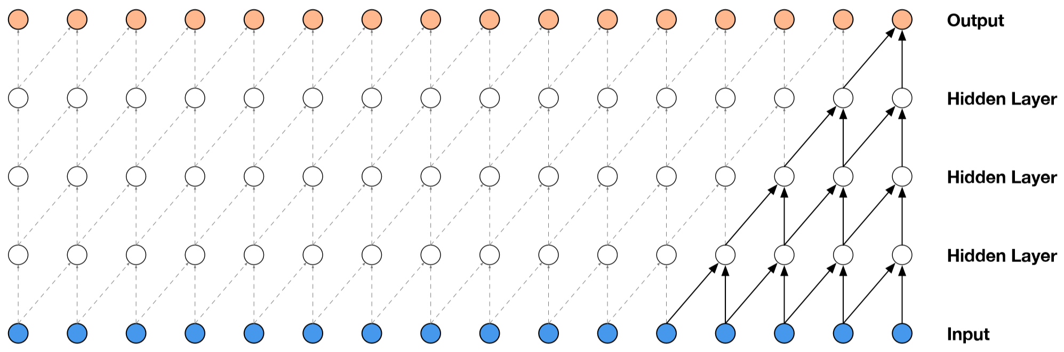
Causal Convolution
Only existing (no future) data is used in each neuron
a stack of causal conv. layers
Oord et al. WaveNet: A Generative Model for Raw Audio.

Slide 15



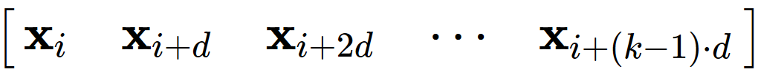
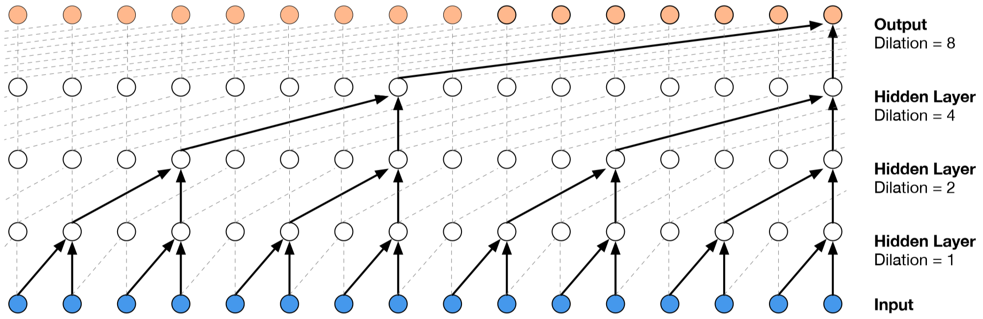
Dilated Convolution
With dilation width , the conv. window starts at location of size is
stack of dilated causal convolutional layers
Oord et al. WaveNet: A Generative Model for Raw Audio.

Slide 16
Dilated-CNN Advantages
Increases receptive field
        Receptive field is the part of the data visible to a neuron
        Exponentially increasing the dilation factor results in exponential receptive field growth
Captures global view of the input with less parameters
Handles temporal flow with causal structure
K. He, X. Zhang, S. Ren, and J. Sun. Deep Residual Learning for Image Recognition.

Slide 17
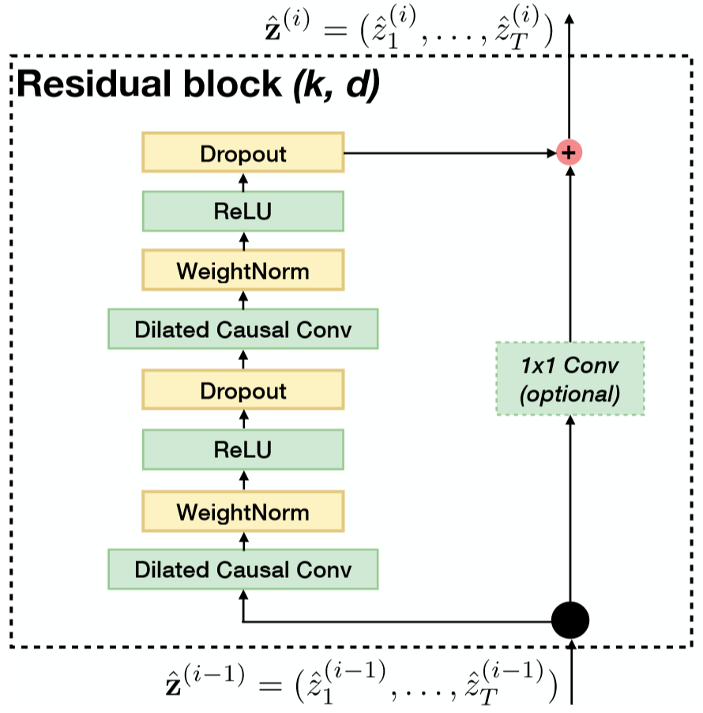


Dilated-CNN Design
… …
ReLU activation: , where .
Dropout for regularization
Use WeightNorm or BatchNorm to speed up convergence
Use skip connection to avoid degradation of model performance when adding more layers
Concatenate building blocks to increase model capacity
S. Bai, J. Kolter, and V. Koltun. An Empirical Evaluation of Generic Convolutional and Recurrent Networks for Sequence Modeling.
.

Slide 18
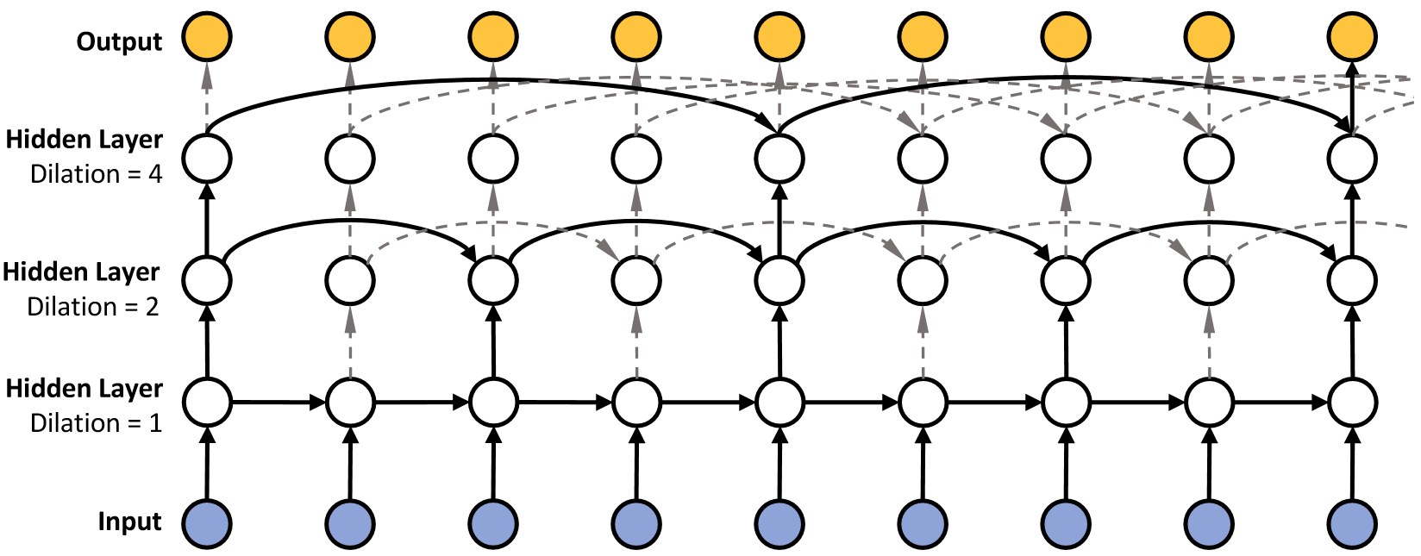
Dilated-RNNs
example of a three-layer Dilated-RNN with dilation 1, 2, and 4
Chang et al. Dilated Recurrent Neural Networks.

Slide 19
Agenda
Overview of Time Series Forecasting Methods
Foundations of Dilated Convolutional Neural Networks
Application to Retail Demand Forecasting

Slide 20
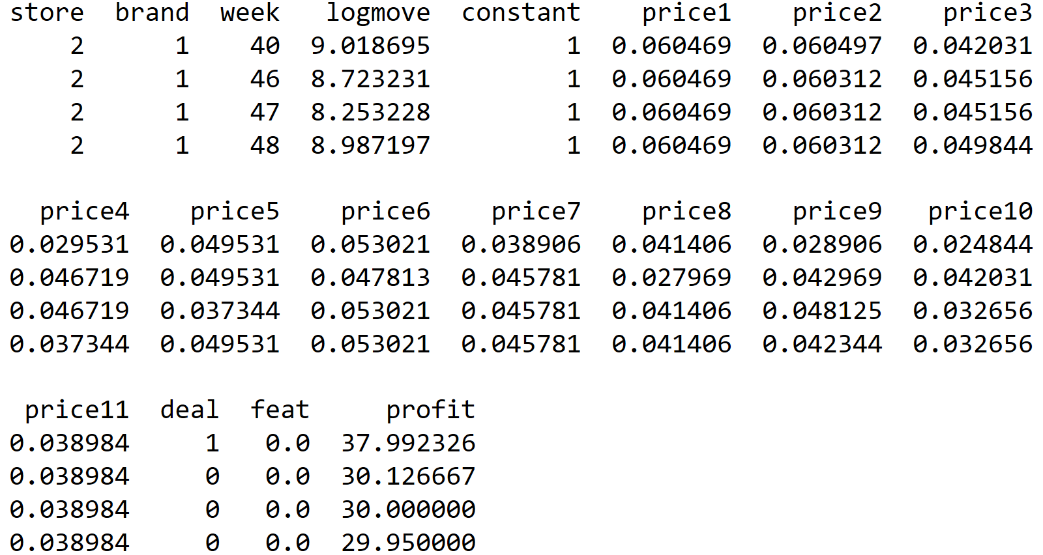
Application to Retail Demand Forecasting
OrangeJuice dataset in bayesm R package
83 stores
11 brands
121 weeks
https://cran.r-project.org/web/packages/bayesm/bayesm.pdf

Slide 21
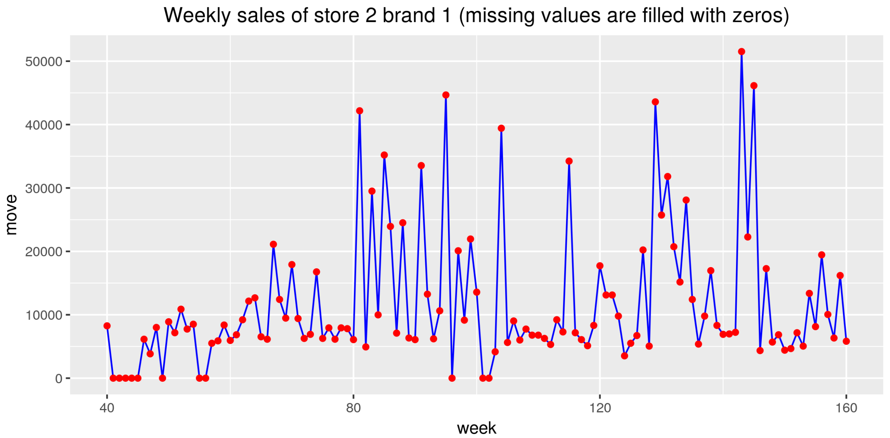
Sample Data

Slide 22
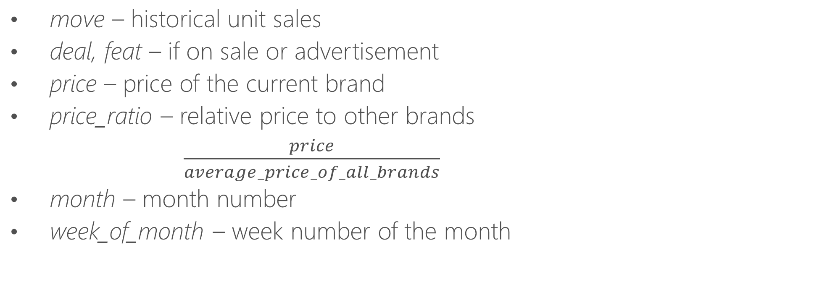
Feature Engineering
move – historical unit sales
deal, feat – if on sale or advertisement
price – price of the current brand
price_ratio – relative price to other brands
$\frac{price}{average_price_of_all_brands}$
month – month number
week_of_month – week number of the month

Slide 23
Data Transformation
……
feature 1 feature 2 feature n
features
created
at time t
(# of lags, # of features)
lag 1
lag 2
……
feature 1 feature 2 feature n
lag 1
lag 3
features
created
at time t+1
lag 2
(# of samples,
# of lags, # of features)
lag 3
……
……

Slide 24
Network Structure
_{Lambda}
_{Embedding}
_{Flatten}
_{Input Layer2}
_{store id,}
_{brand id}
_{Lambda}
_{Embedding}
_{Flatten}
_{Dense}
_{Dense}
_{Concatenate}
_{move, deal,}
_{feat, price, price ratio,}
_{month, week_of_}
_{month}
_{Input Layer1}
_{Conv 1D}
_{Conv 1D}
_{Conv 1D}
_{Conv 1D}
_{Dropout}
_{Flatten}
_{Concatenate}
_{[#samples, 15, 7]}
_{[#samples, 15, 3]}

Slide 25
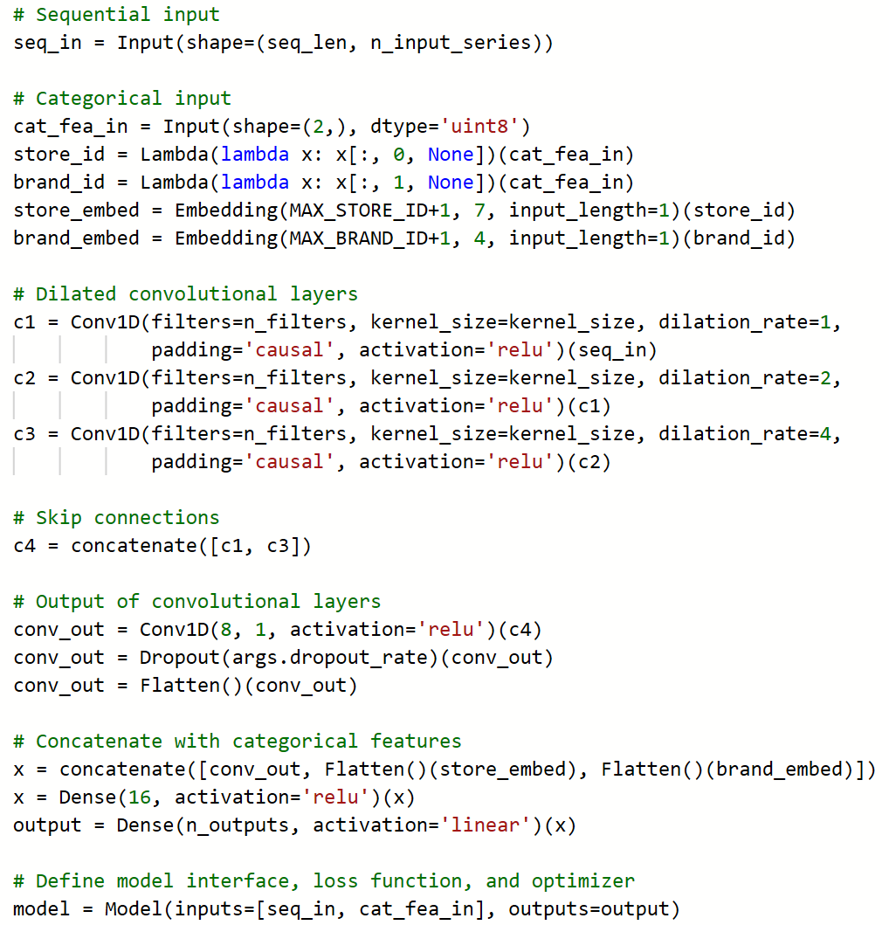
Model Definition
Embedding: encode categorical features into binary sequences
Conv1D
        n_filters
        kernel_size
        dilation_rate
        padding
        activation function
Skip connections
Combine with categorial features and pass to a dense layer

Slide 26
Model Definition
Embedding: encode categorical features into binary sequences
Conv1D
        n_filters
        kernel_size
        dilation_rate
        padding
        activation function
Skip connections
Combine with categorial features and pass to a dense layer

Slide 27
Model Definition
Embedding: encode categorical features into binary sequences
Conv1D
        n_filters
        kernel_size
        dilation_rate
        padding
        activation function
Skip connections
Combine with categorial features and pass to a dense layer

Slide 28
Model Definition
Embedding: encode categorical features into binary sequences
Conv1D
        n_filters
        kernel_size
        dilation_rate
        padding
        activation function
Skip connections
Combine with categorial features and pass to a dense layer

Slide 29
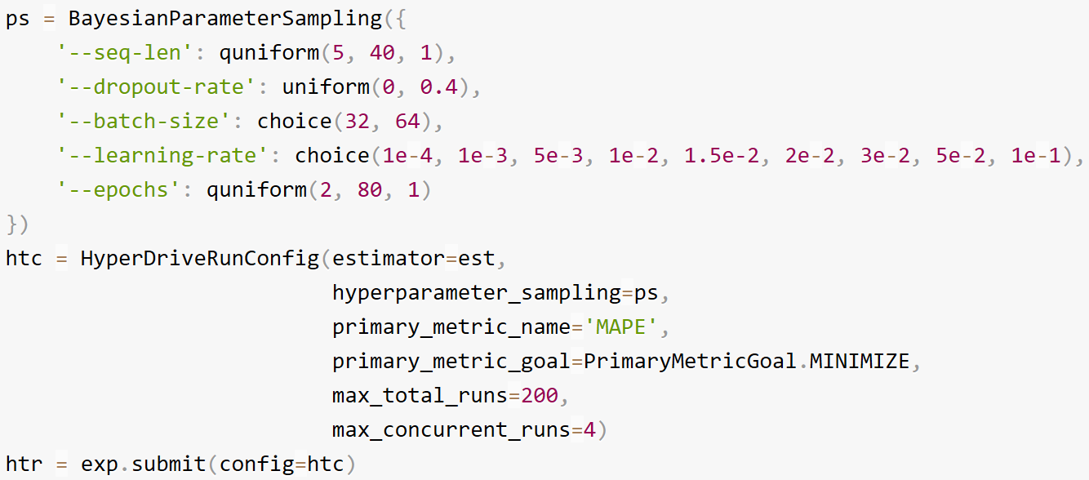
Hyperparameter Tuning
HyperDrive via Azure Machine Learning SDK
        Automates the hyperparameter sweeps on an elastic cluster
        Supports Bayesian sampling and early termination
https://docs.microsoft.com/en-us/azure/machine-learning/service/how-to-tune-hyperparameters

Slide 30
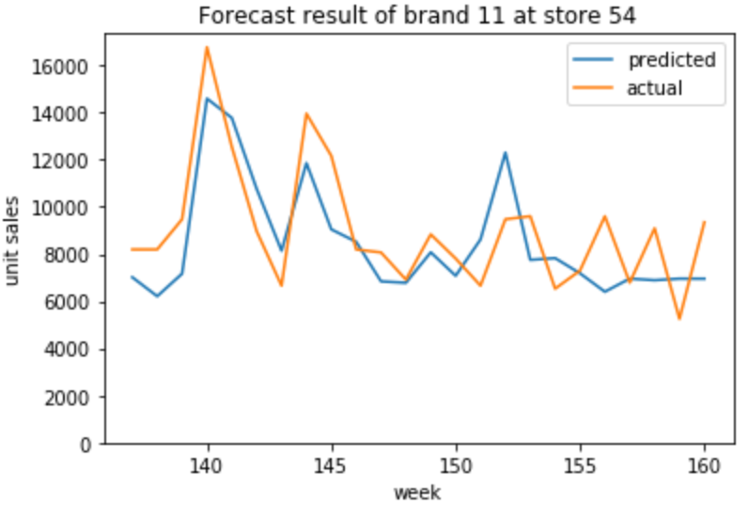
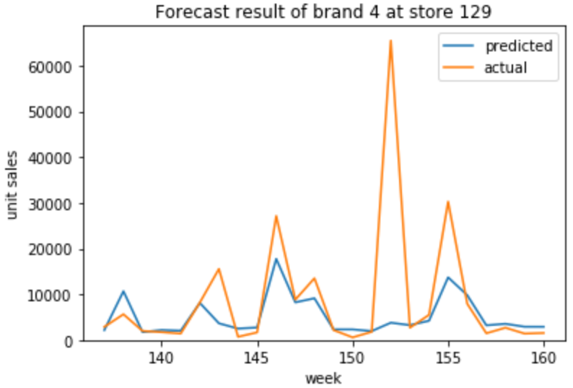
Results
Forecast unit sales between week 138 and 160 with model retrained every 2 weeks
Azure Ubuntu Linux VM with one-half Tesla K80 GPU, 56 GB memory

Slide 31
Results
Mean absolute percentage error (MAPE)
Method | MAPE | Running time | Machine
Dilated CNN | 37.09 % | 413 s | GPU Linux VM
Seq2Seq RNN | 37.68 % | 669 s | GPU Linux VM
Naive | 109.67 % | 114.06 s | CPU Linux VM
ETS | 70.99 % | 277.01 s | CPU Linux VM
ARIMA | 70.80 % | 265.94 s | CPU Linux VM
Results are collected based on the median of 5 run results

Slide 32
Thank you!

Slide 33


Rate today ’s session
Session page on conference website
O’Reilly Events App

